Slide 1
Dynamic Weather Dashboard
Aditya Chauhan
Birla Institute of Applied Sciences
CSE

Slide 2
Problem Statement
Users often need real-time, location-based weather updates in a simple and quick interface.
Most existing apps are heavy or overloaded with features.
This project provides a lightweight dashboard that shows weather details like temperature, conditions, and forecasts.

Slide 3
System Development Approach
Frontend Technologies:
• HTML – Structure of the webpage
• CSS – Styling and responsiveness
• JavaScript – Dynamic interactivity
APIs Used:
• OpenWeatherMap API – Real-time weather data
• Geolocation API – Auto-detect user’s location

Slide 4
Algorithm & Deployment
1. Get user location using Geolocation API.
2. Fetch weather data from OpenWeatherMap API.
3. Display temperature, humidity, and forecast.
4. Allow city search if location is denied.
5. Deploy using GitHub Pages / Netlify / Vercel.

Slide 5
Features
• Automatic location detection
• Display temperature, humidity, pressure, wind
• Forecast view
• Sunrise & sunset times
• Responsive design
• City search fallback

Slide 6
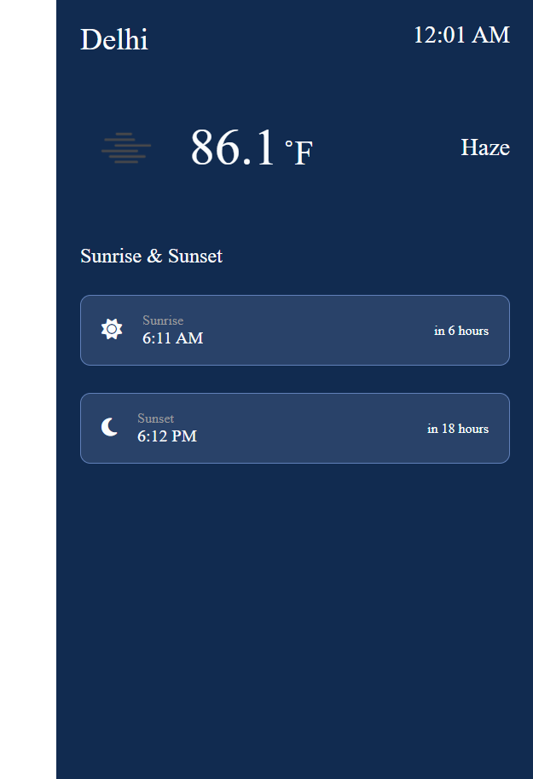
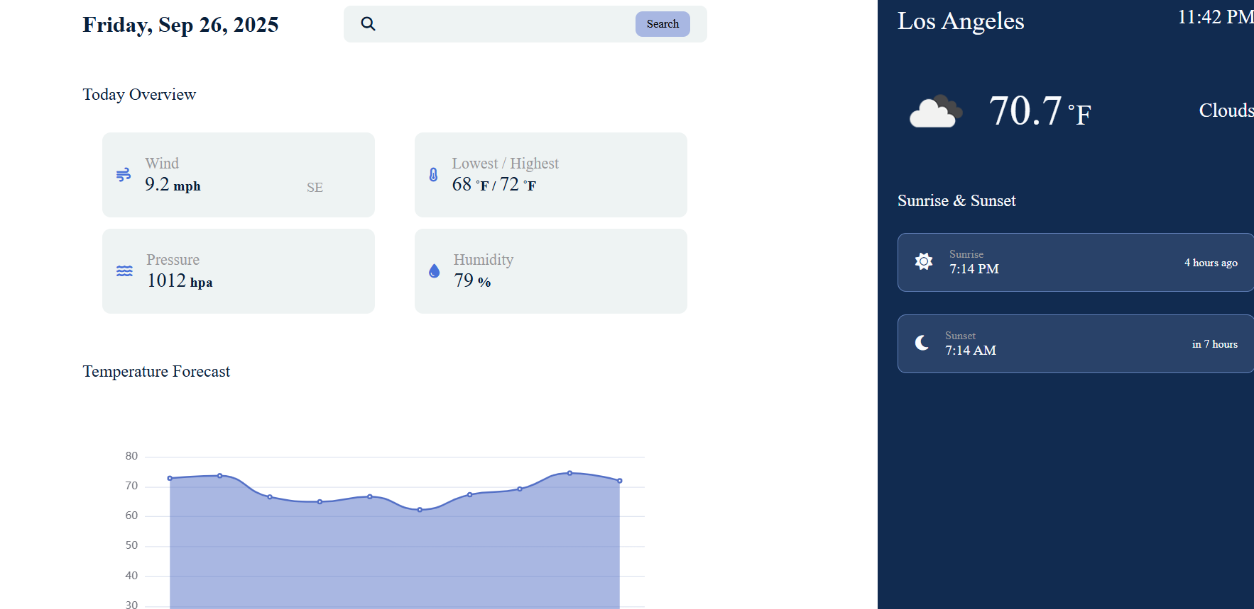
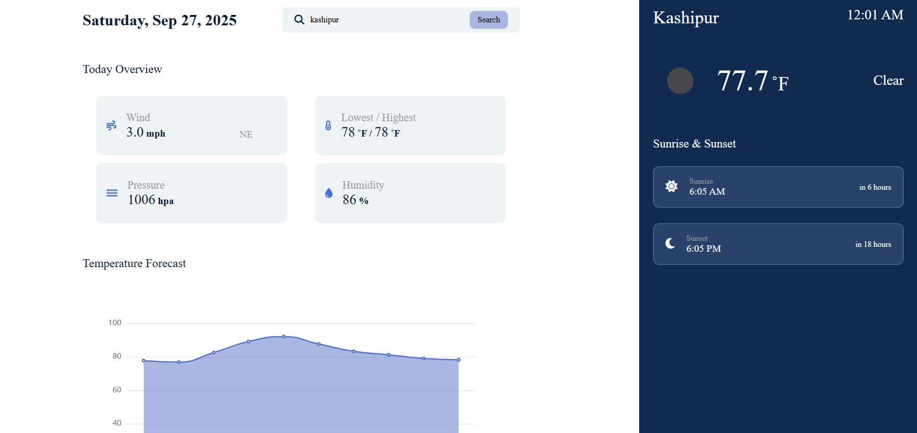
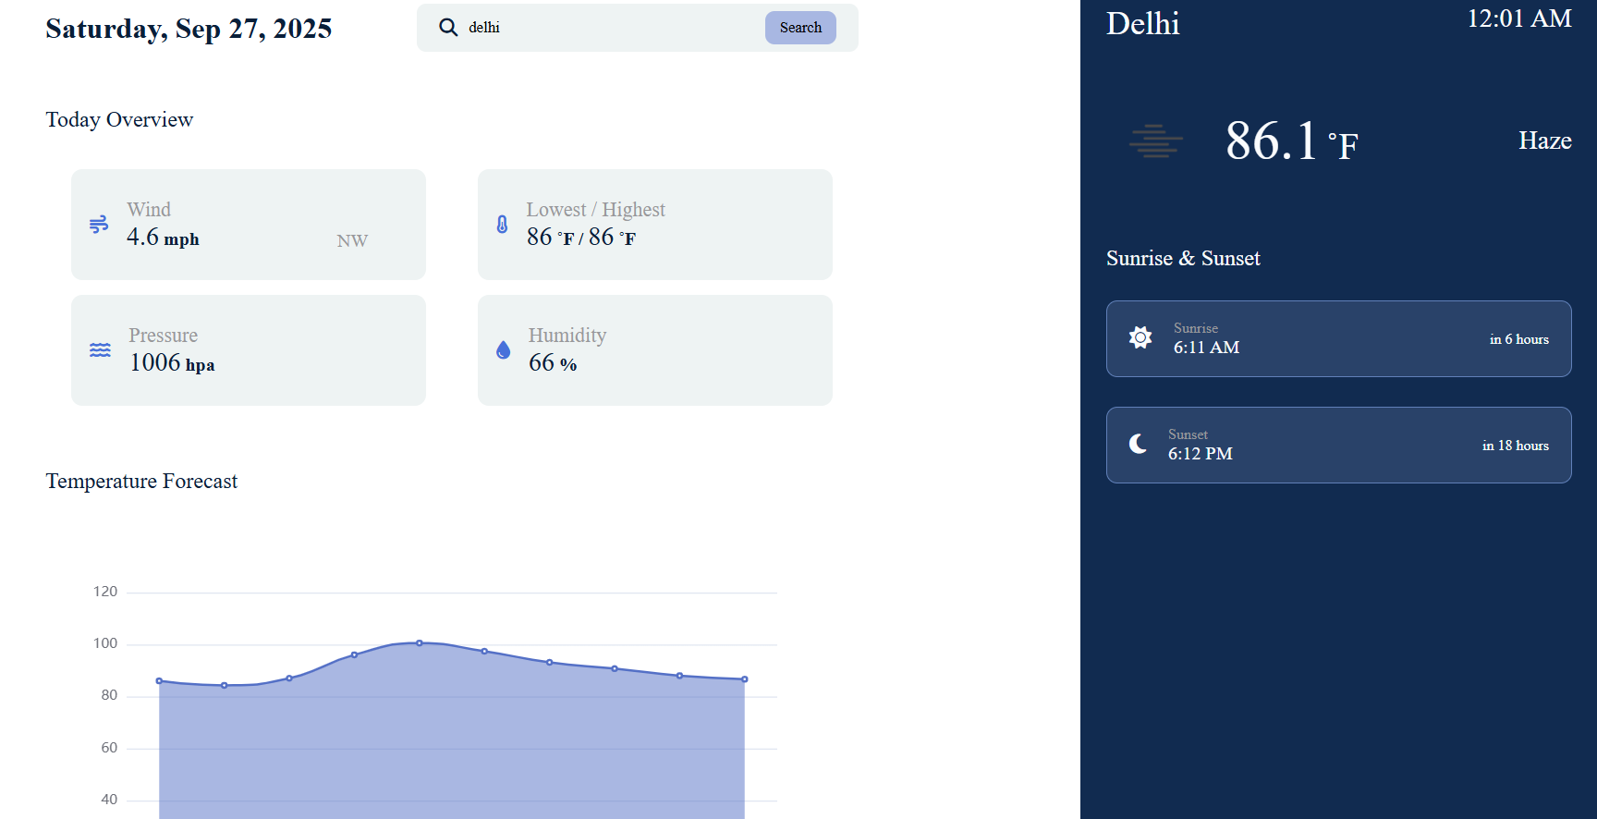
Screenshots / Demo

Slide 7
Live & Repository Links
GitHub Repository:
https://github.com/aditya08chauhan/Weather-App
Live Deployment:
https://aditya08chauhan.github.io/Weather-App/

Slide 8
Results / Observations
• Real-time weather updates
• Location-based detection + search option
• Clean, mobile-friendly interface
• Successfully deployed and working online

Slide 9
Challenges & Solutions
• API rate limits – handled with efficient API calls
• Geolocation denial – added manual city search fallback
• Responsive design – fixed with CSS media queries
• Cross-browser testing – ensured compatibility

Slide 10
Future Scope
• Add 7-day detailed forecast & graphs
• Weather alerts & push notifications
• Map view with weather overlays
• Dark mode toggle
• Support for multiple languages

Slide 11
Conclusion
This project provides a lightweight and cost-free weather solution.
It is useful for daily users and travelers, providing real-time and accurate data.
Deployed successfully, it demonstrates the power of APIs and responsive web design.

Slide 12
References
• OpenWeatherMap API Documentation
• Geolocation API Documentation
• GitHub: https://github.com/aditya08chauhan/Weather-App

